Slide 1
Session 14: Hybrid Quantitative Modeling
approaches with application to health & safety
PJ Giabbanelli, M Baniukiewicz, VS Pillutla, R Flarsheim

Slide 2
Logistics
11:15 – 12:30
We welcome questions during the demo
Beyond this talk…
Want to learn more? Help yourself to a paper on safety or health!
Want to collaborate? giabba@cs.niu.edu
Giabbanelli et al.
Hybrid quantitative modeling
2

Slide 3
Organization of this demo
Why bother?
How to decompose a problem so it can use multiple modeling techniques
Our combination
Using fuzzy cognitive map (locally) and networks (globally)
Doing it in practice
Ilustration through a software environment
What’s next?
Resources to put it into practice
Giabbanelli et al.
Hybrid quantitative modeling
3

Slide 4
Why bother
Giabbanelli et al.
Hybrid quantitative modeling
4

Slide 5
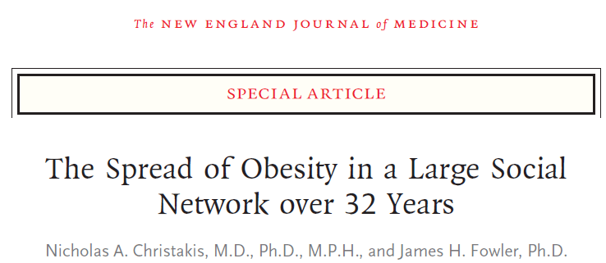
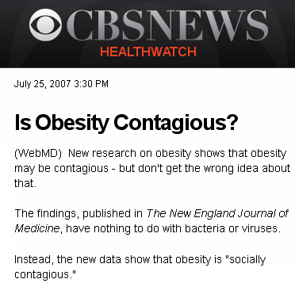
Why bother
PUBLISH
NOW!!
Giabbanelli et al.
Hybrid quantitative modeling
5

Slide 6
Why bother
Change state
No change
W. Rush, et al., Tech. rep NECSI 2003
Unhealthy
Healthy
Giabbanelli et al.
Hybrid quantitative modeling
6

Slide 7
Why bother
Bahr et al. proposed a model of obesity in which you become obese if half of your friends are obese.
D. Bahr, R. Browning, H. Wyatt, J. Hill, Exploiting social networks to mitigate the obesity epidemic, Obesity 17 (2009) 723-728
Giabbanelli et al.
Hybrid quantitative modeling
7

Slide 8
Why bother
But if we want to model it ‘right’, we know that it’s not the mere presence of overweight people that makes you gain weight. They don’t sneeze their weight on you!
Giabbanelli et al.
Hybrid quantitative modeling
8

Slide 9
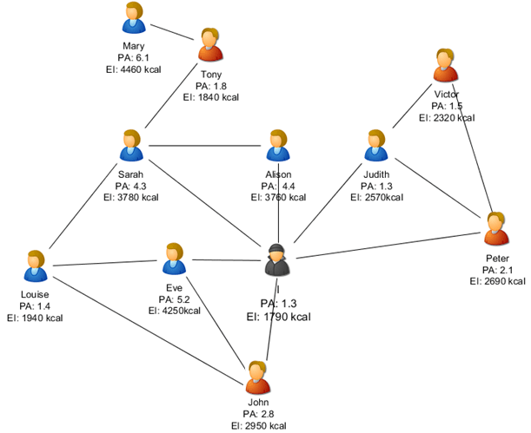
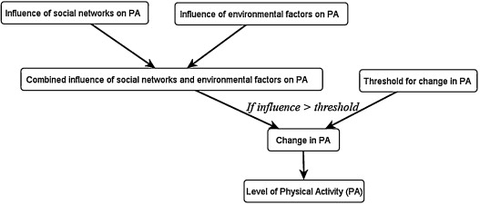
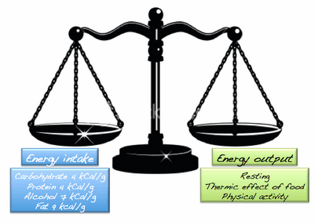
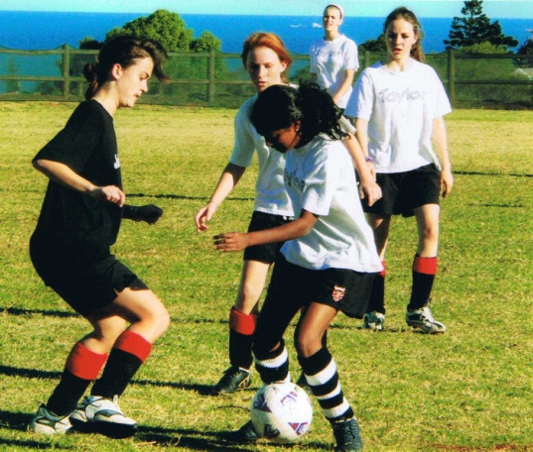
Why bother
Eating
Exercising
Giabbanelli et al.
Hybrid quantitative modeling
9

Slide 10
Why bother
+5 kg
Individual context matters!
• You tell me to cycle to work. Active travel is nice, but I live 50miles away!
• I agree that healthy cooking is great, but I don’t have the money or knowledge for it!
Giabbanelli et al.
Hybrid quantitative modeling
10

Slide 11
Why bother
You need a way to model:
• Global dynamics. Social norms spread through a social network.
Agent-based model. Network model. Cellular automaton.
• Local context. What a norm might change in somebody’s life depends on a complex decision-making process, highly sensitive to one’s specific context.
Fuzzy Cognitive Maps. System dynamics.
Giabbanelli et al.
Hybrid quantitative modeling
11

Slide 12
Our combination
Giabbanelli et al.
Hybrid quantitative modeling
12

Slide 13
Our combination
Network between individuals, fuzzy cognitive map within individuals
Lilian
Martha
SES
Exercise
Garnet
SES
Exercise
Obesity
SES
Exercise
Stigma
Obesity
Food intake
Obesity
Stigma
Stigma
Gender
Food intake
Food intake
Gender
Gender
Giabbanelli et al.
Hybrid quantitative modeling
13

Slide 14
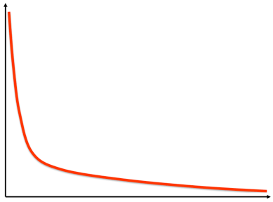
Our combination
Initialization
Matching
Simulation
Nate
Andrea
Philippe
Steven
Sriram
Giabbanelli et al.
Hybrid quantitative modeling
14

Slide 15
Our combination
Initialization
Matching
Simulation
Nate
Andrea
Philippe
Influencing
Influenced
Steven
Sriram
Giabbanelli et al.
Hybrid quantitative modeling
15

Slide 16
Our combination
Initialization
Matching
Simulation
Nate
Andrea
Philippe
Steven
Sriram
Giabbanelli et al.
Hybrid quantitative modeling
16

Slide 17
Our combination
Nate
Exercise
.2
Philippe
SES
Awareness of diabetes
1
Exercise
.5
.8
Diabetes
SES
Awareness of diabetes
0
.7
.3
0
Obesity
1
.2
.8
Diabetes
Obesity
0
.3
Giabbanelli et al.
Hybrid quantitative modeling
17

Slide 18
Our combination
Frequently Asked Questions and Whining
(1) So now I have to develop a network model AND a fuzzy cognitive map? That’s a lot!
There are lots of Fuzzy Cognitive Maps out there. Ask Steven Gray or I ☺ And making a network model is fast. So you’ll spend time on combining.
Giabbanelli et al.
Hybrid quantitative modeling
18

Slide 19
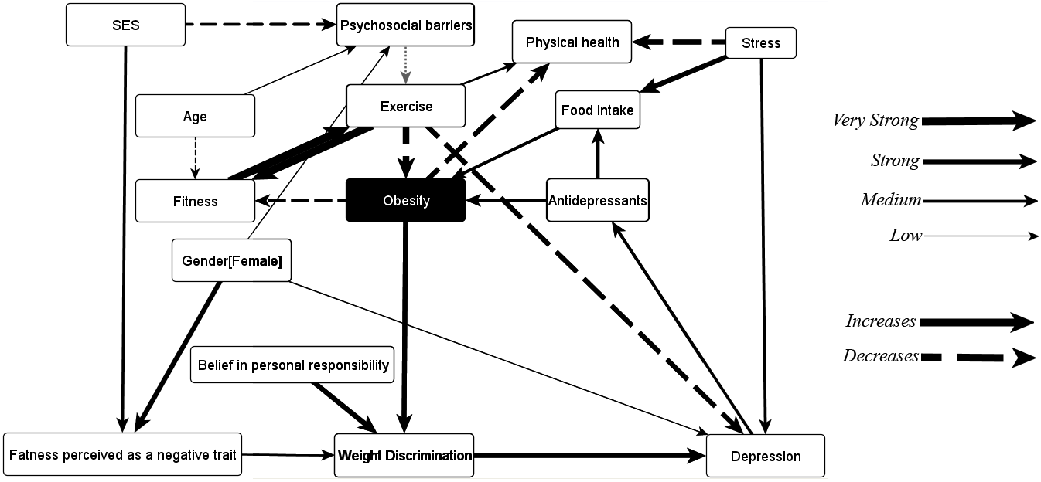
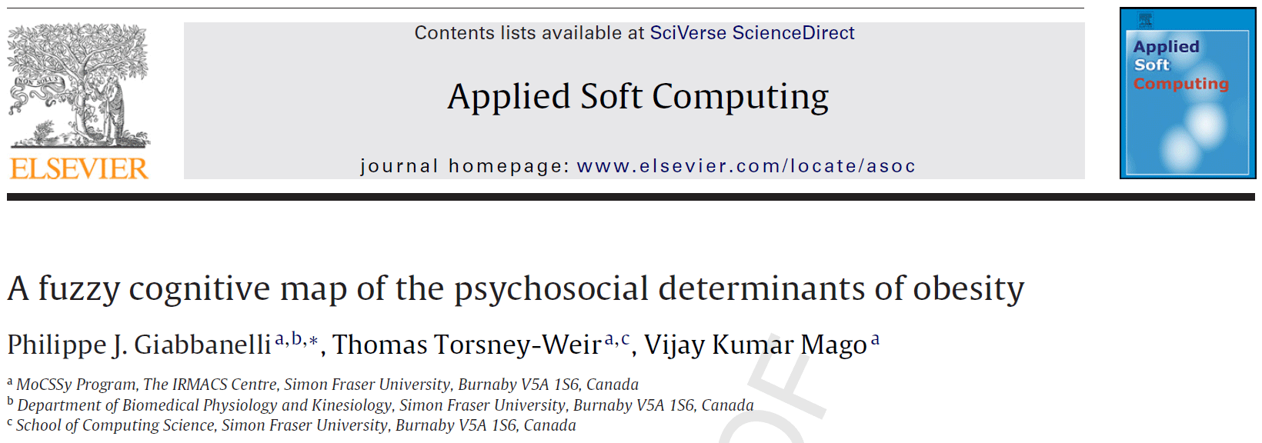
Our combination
Frequently Asked Questions and Whining
(1) So now I have to develop a network model AND a fuzzy cognitive map? That’s a lot!
There are lots of Fuzzy Cognitive Maps out there. Ask Steven Gray or I ☺ And making a network model is fast. So you’ll spend time on combining.
Giabbanelli et al.
Hybrid quantitative modeling
19

Slide 20
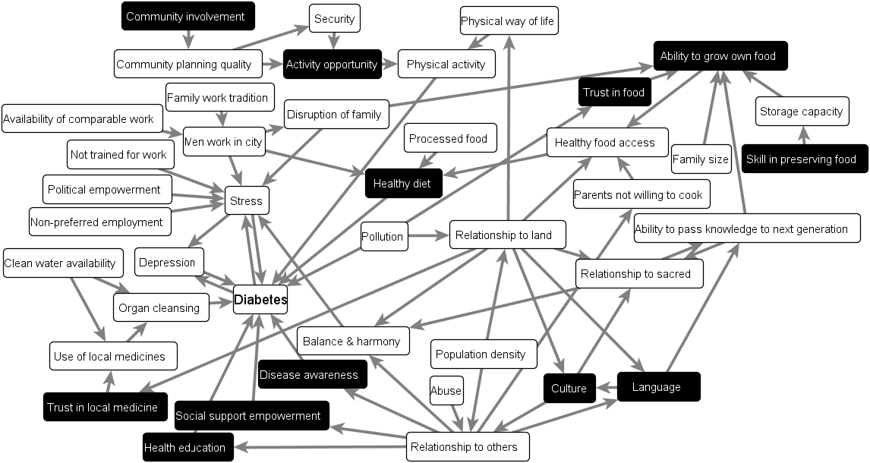
Our combination
Frequently Asked Questions and Whining
B. Giles et al., Soc Sci Med 64(3), 562 (2007)
Giabbanelli et al.
Hybrid quantitative modeling
20

Slide 21
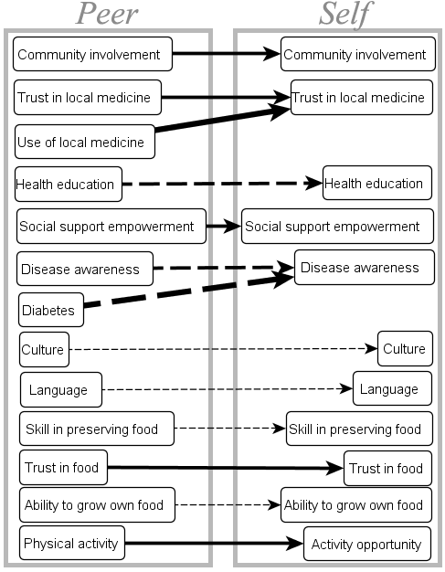
Our combination
Frequently Asked Questions and Whining
Giabbanelli et al.
Hybrid quantitative modeling
21

Slide 22
Our combination
Frequently Asked Questions and Whining
(2) I model geographical systems, not social systems. So is that stuff really for me?
Our guiding example was on social norms and individual context. But you can also have a geographical network with local context!
Giabbanelli et al.
Hybrid quantitative modeling
22

Slide 23
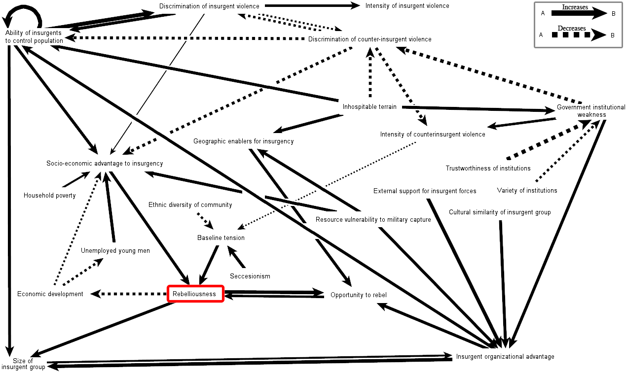
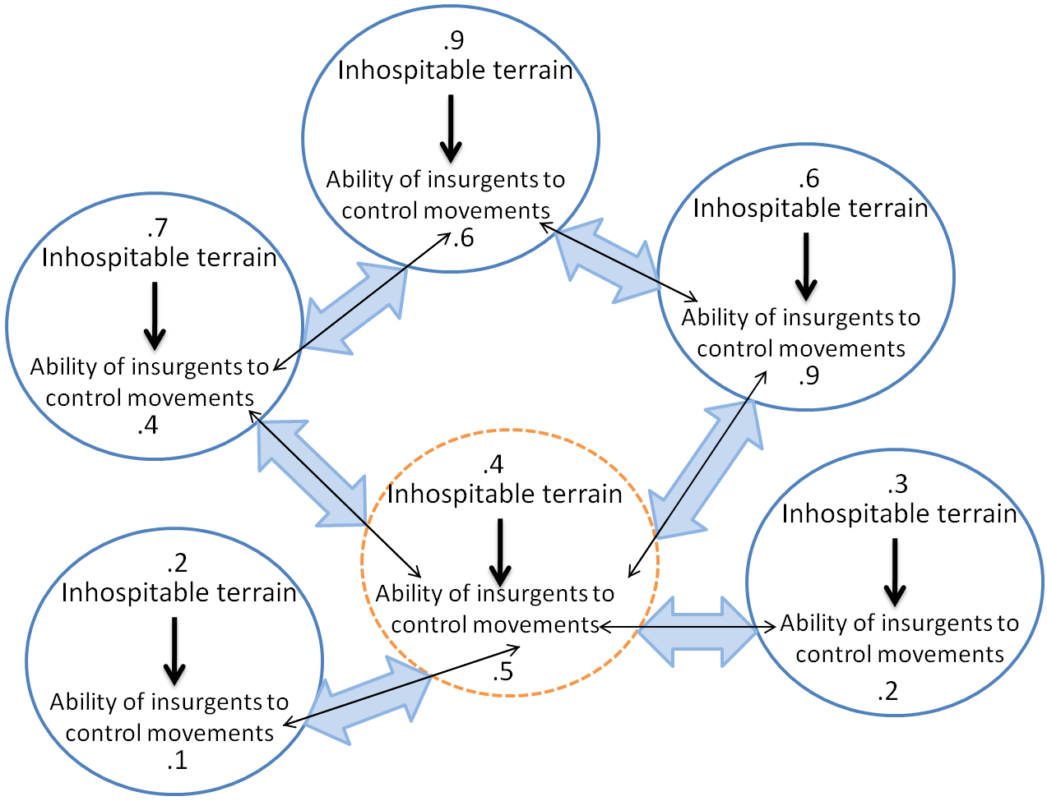
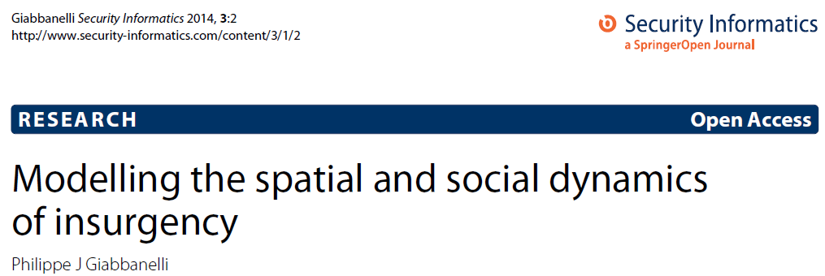
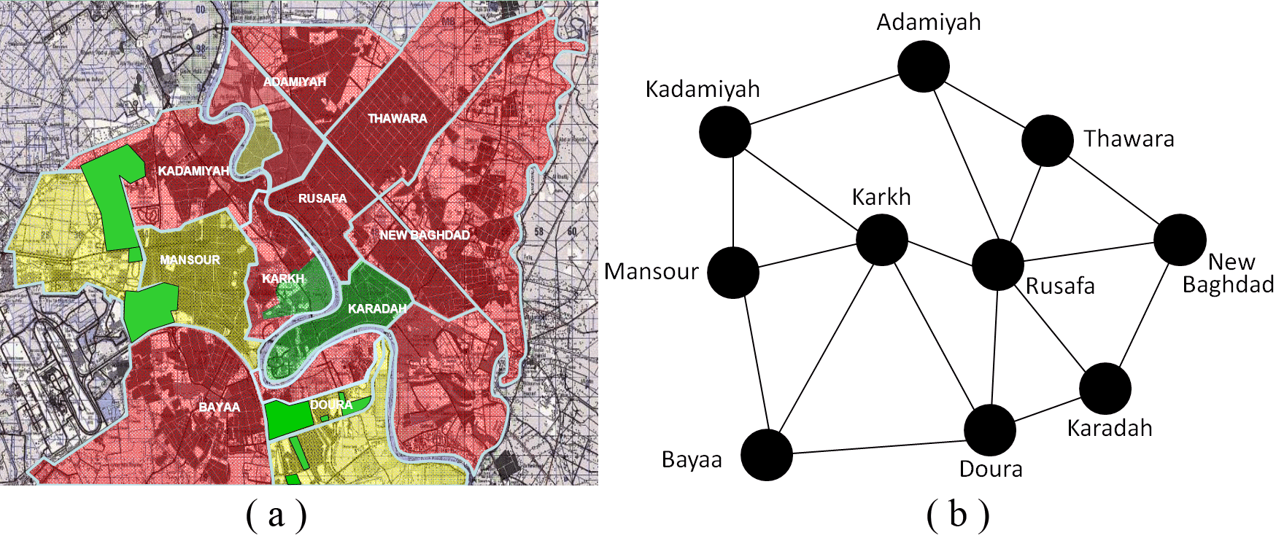
Our combination
Frequently Asked Questions and Whining
(2) I model geographical systems, not social systems. So is that stuff really for me?
Our guiding example was on social norms and individual context. But you can also have a geographical network with local context!
Help yourself to a copy!
Giabbanelli et al.
Hybrid quantitative modeling
23

Slide 24
Our combination
Frequently Asked Questions and Whining
(3) How much data do you actually need to run such a model?
Intuitively, the more you want to represent in your model, and the more data you’ll need to initialize it / validate it. We’re talking about highly detailed models, so it gets data intensive.
Giabbanelli et al.
Hybrid quantitative modeling
24

Slide 25
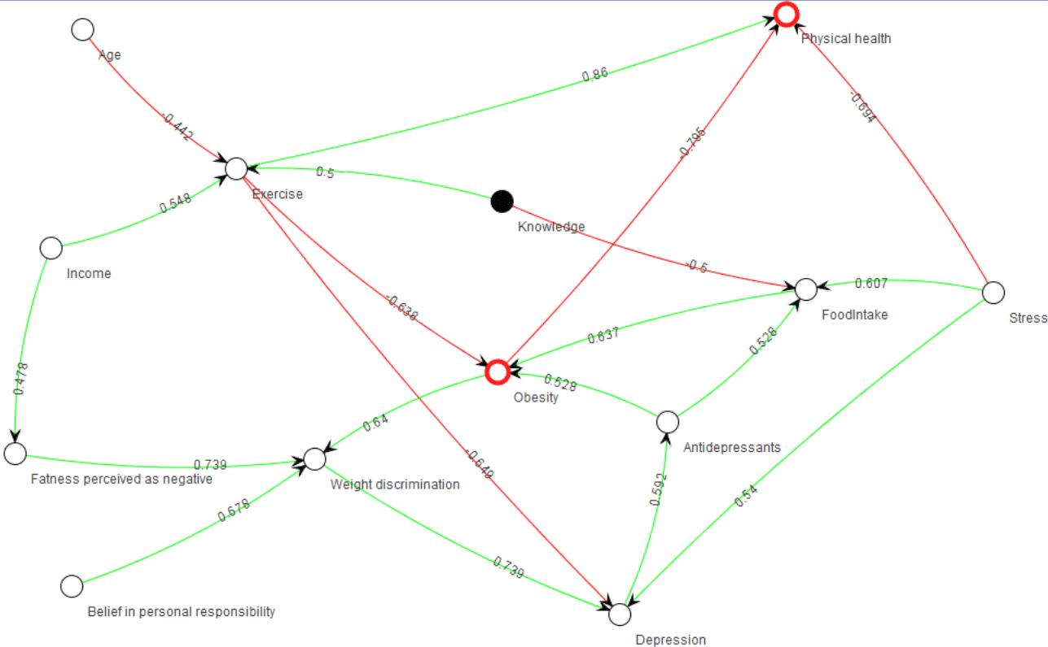
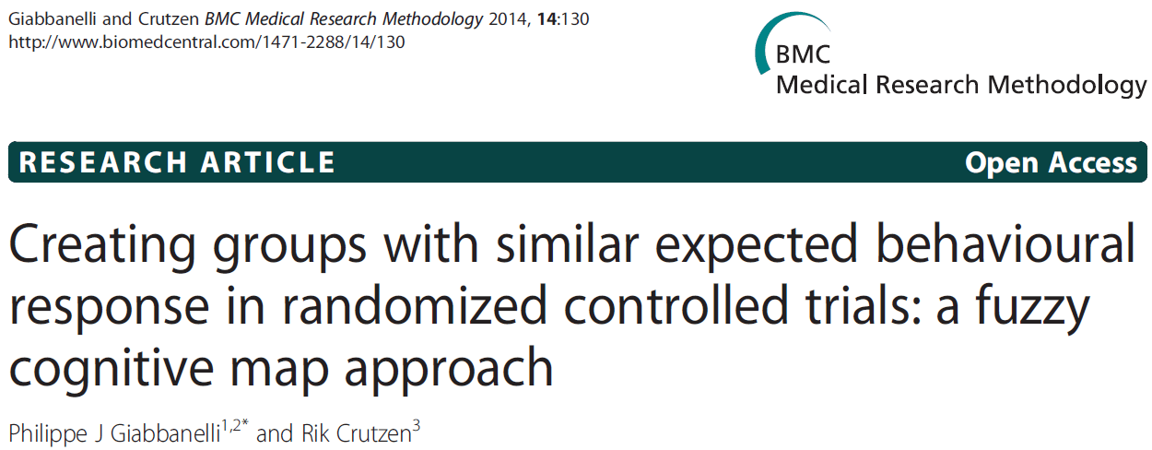
Our combination
You need data to get the weights of the FCM
Frequently Asked Questions and Whining
(3) How much data do you actually need to run such a model?
Intuitively, the more you want to represent in your model, and the more data you’ll need to initialize it / validate it. We’re talking about highly detailed models, so it gets data intensive.
We’ve developed techniques and software to do that automatically by sending in questionnaires
Giabbanelli et al.
Hybrid quantitative modeling
25

Slide 26
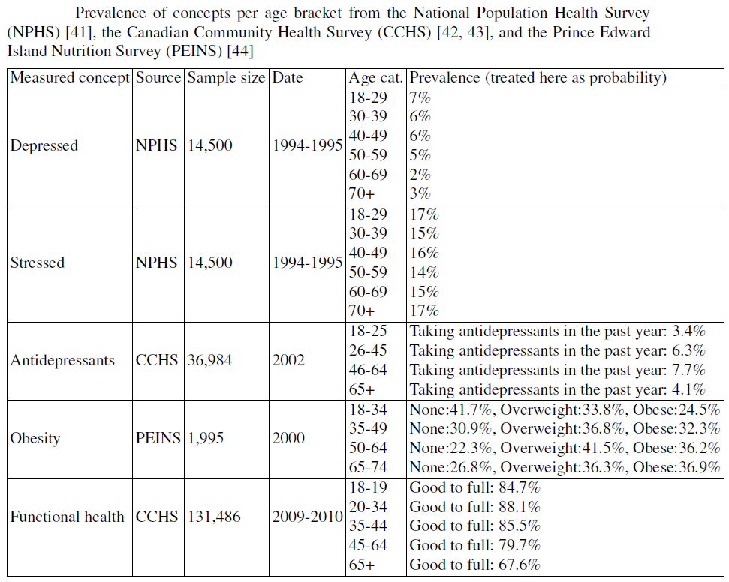
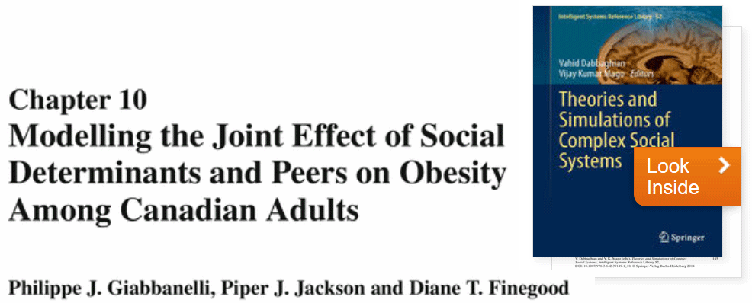
Our combination
You also need data to initialize all concepts
Frequently Asked Questions and Whining
This is where you spend lots of time digging data.
Help yourself to a copy!
(3) How much data do you actually need to run such a model?
Intuitively, the more you want to represent in your model, and the more data you’ll need to initialize it / validate it. We’re talking about highly detailed models, so it gets data intensive.
Also be aware that values are often not independent!
Giabbanelli et al.
Hybrid quantitative modeling
26

Slide 27
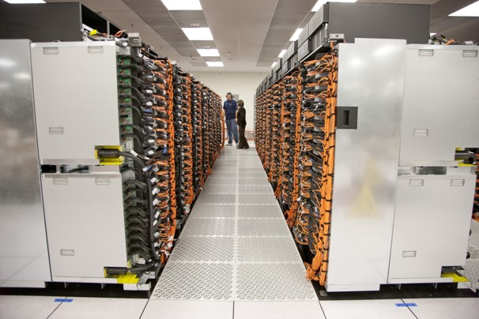
Our combination
Frequently Asked Questions and Whining
(4) If I want to simulate a big population with complex decision making, it’s going to take lots of operations! How scalable is that?
The algorithms parallelize well, so you could implement your model to run on a high-performance computing cluster.
Giabbanelli et al.
Hybrid quantitative modeling
27

Slide 28
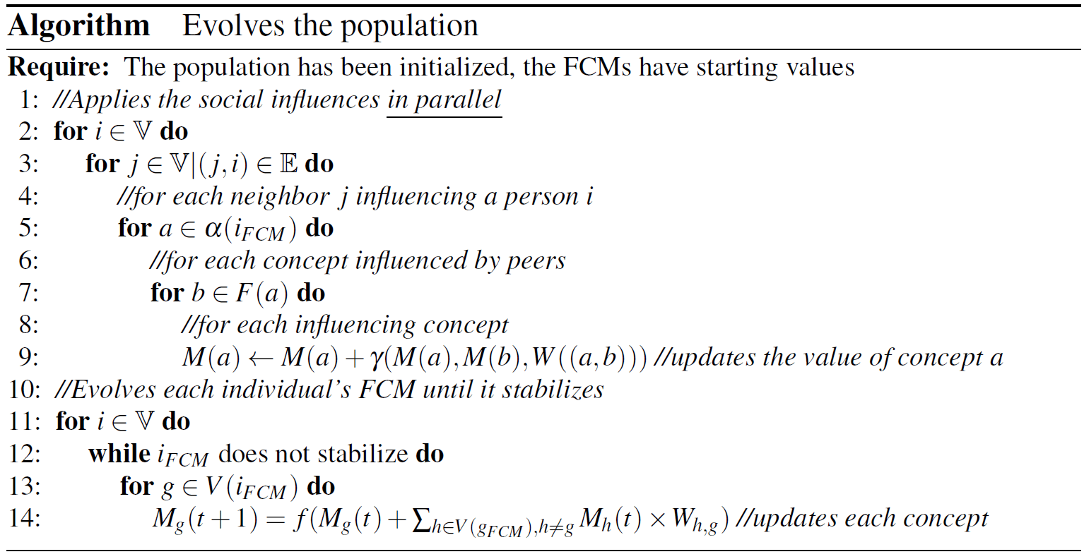
Our combination
Frequently Asked Questions and Whining
Giabbanelli et al.
Hybrid quantitative modeling
28

Slide 29
Doing it in practice
Giabbanelli et al.
Hybrid quantitative modeling
29

Slide 30
Doing it in practice
There are several software packages to do hybrid modeling. AnyLogic can combine agent-based models and system dynamics – check out training great videos by Nate Osgood!
We developed a software to combine networks and fuzzy cognitive maps. We can discuss collaborations and assist you with the implementation if you’d like.
Giabbanelli et al.
Hybrid quantitative modeling
30

Slide 31
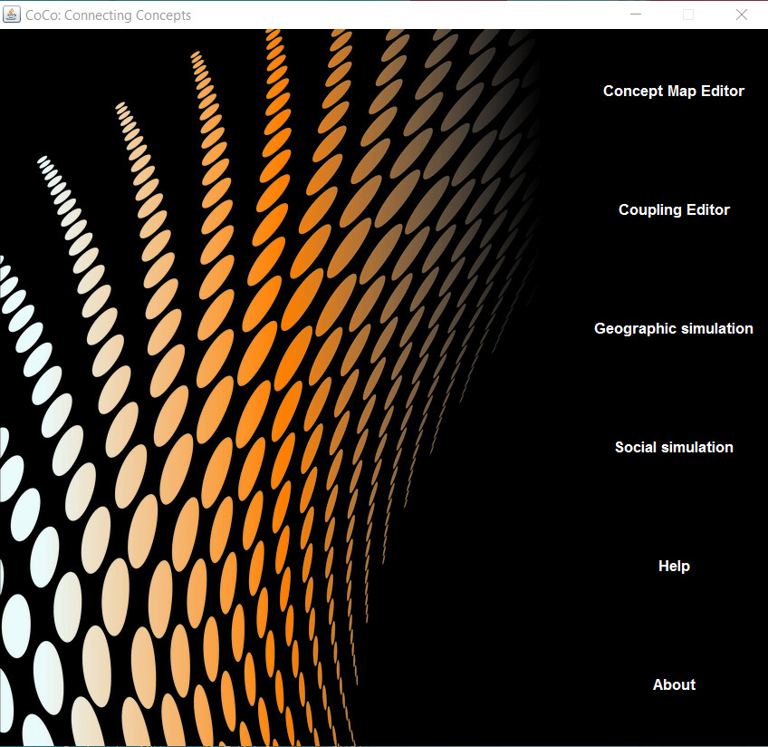
Doing it in practice
Giabbanelli et al.
Hybrid quantitative modeling
31

Slide 32
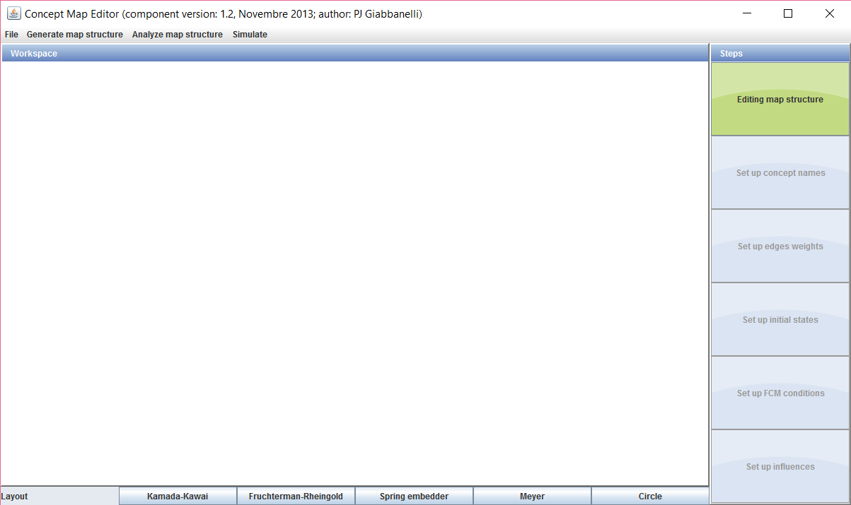
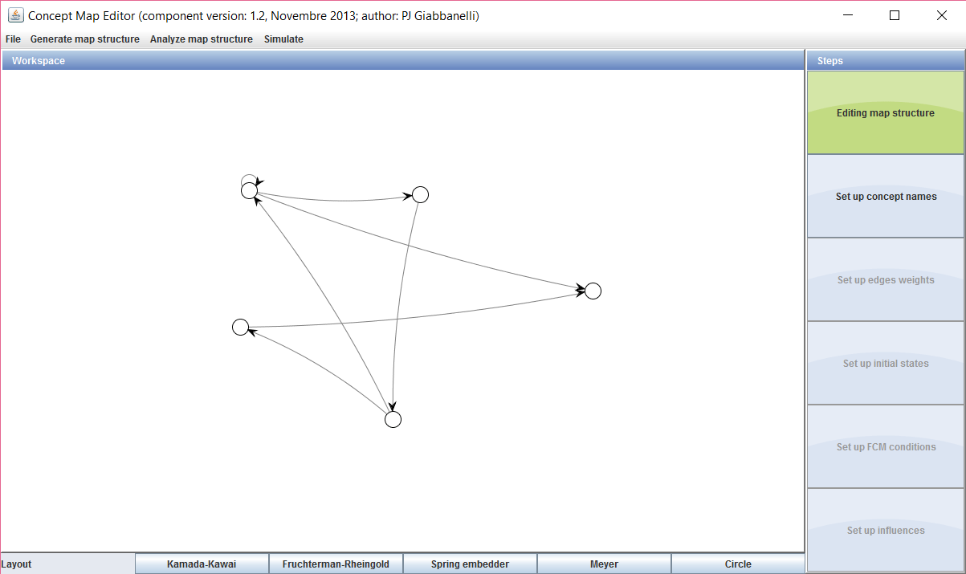
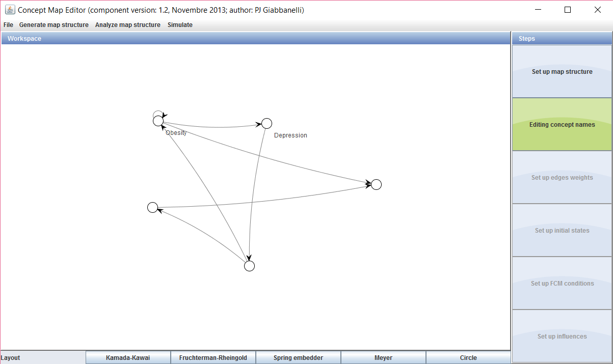
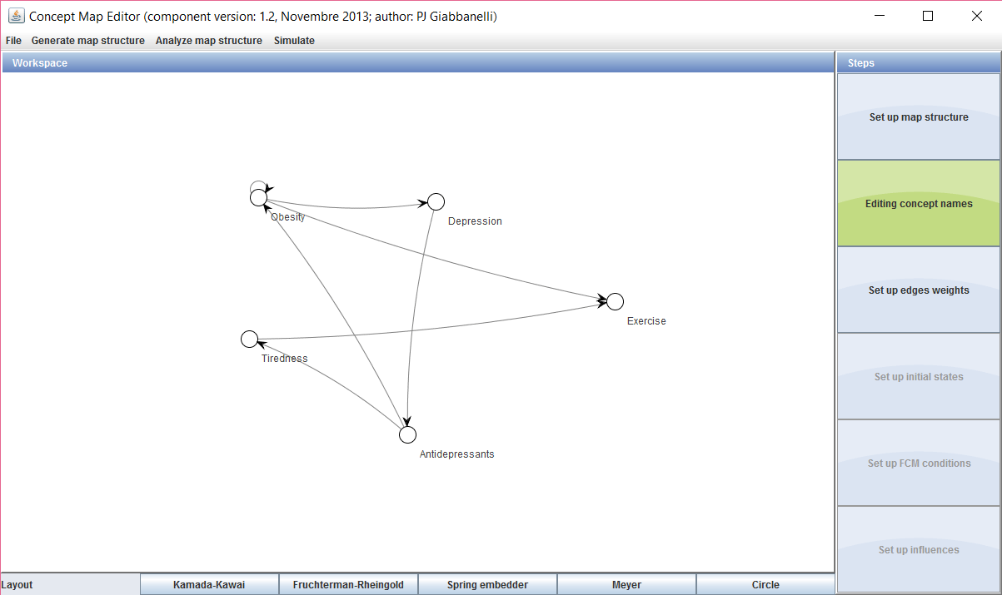
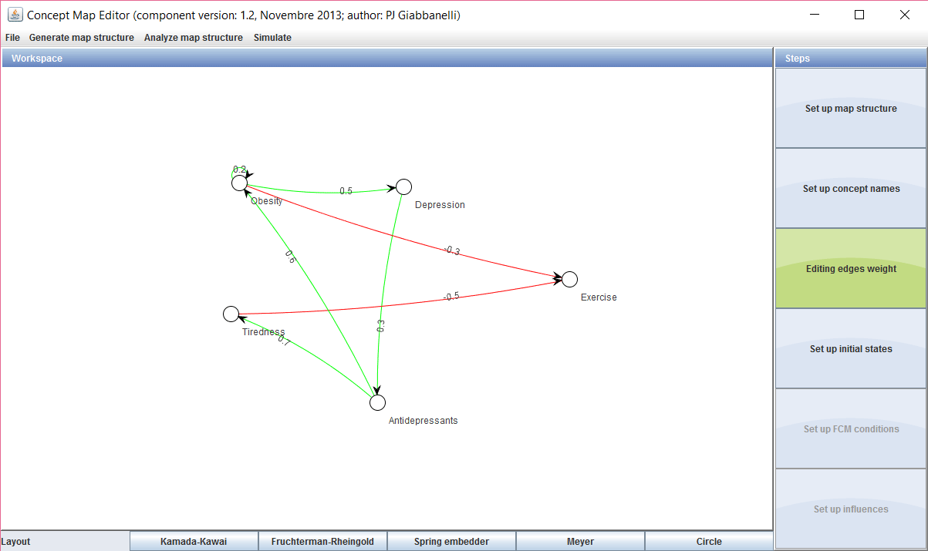
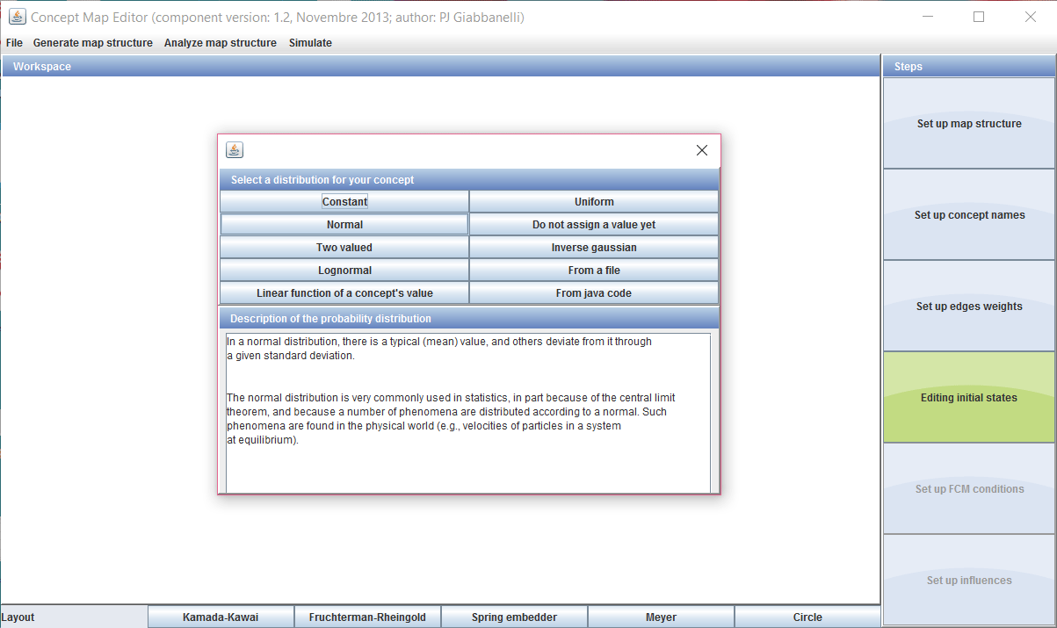
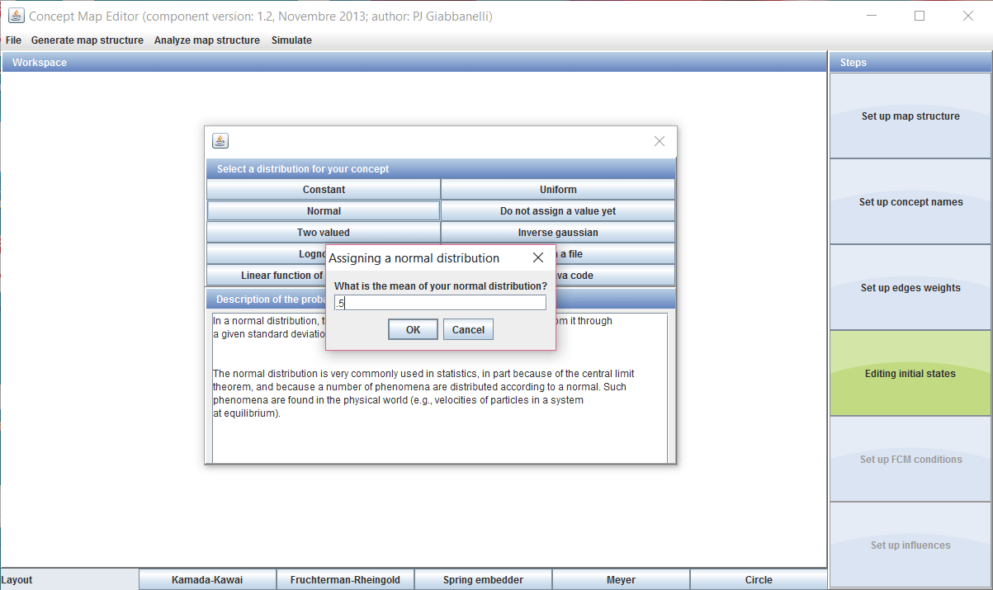
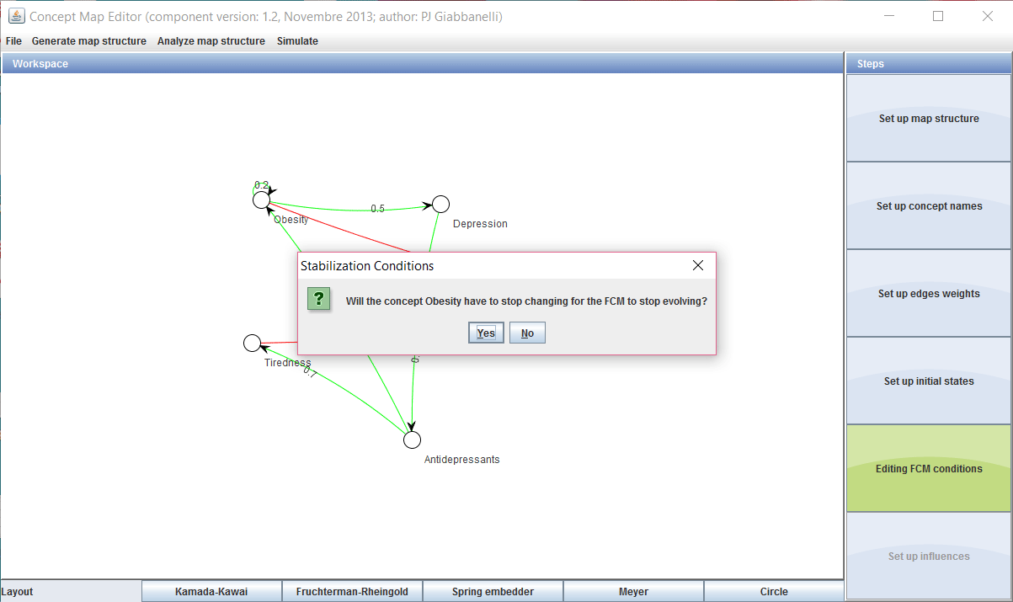
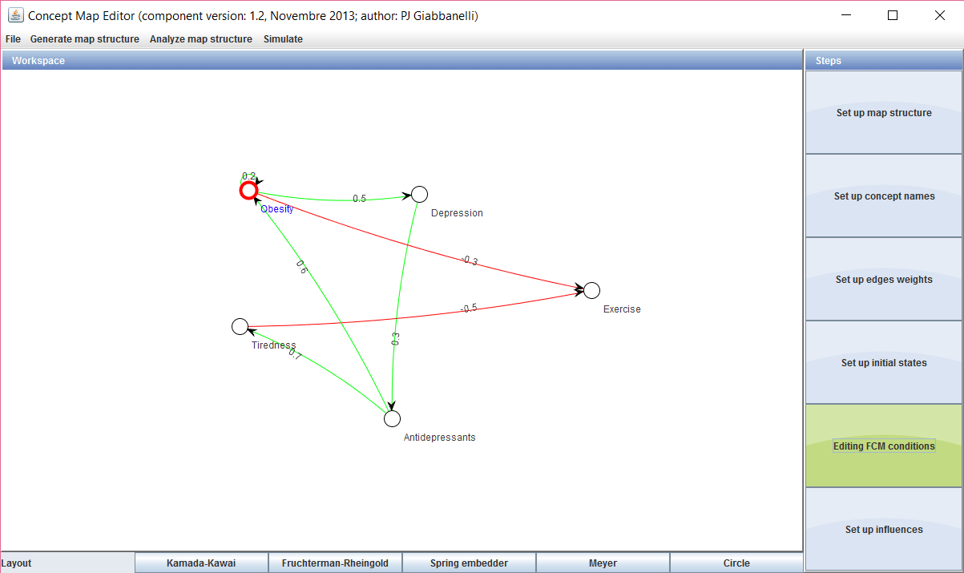
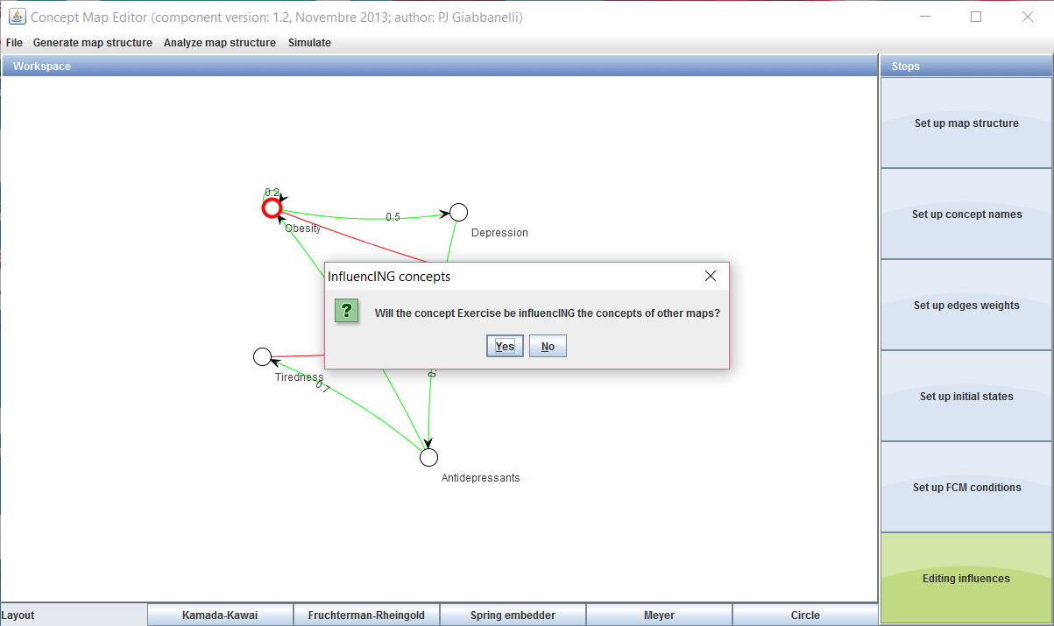
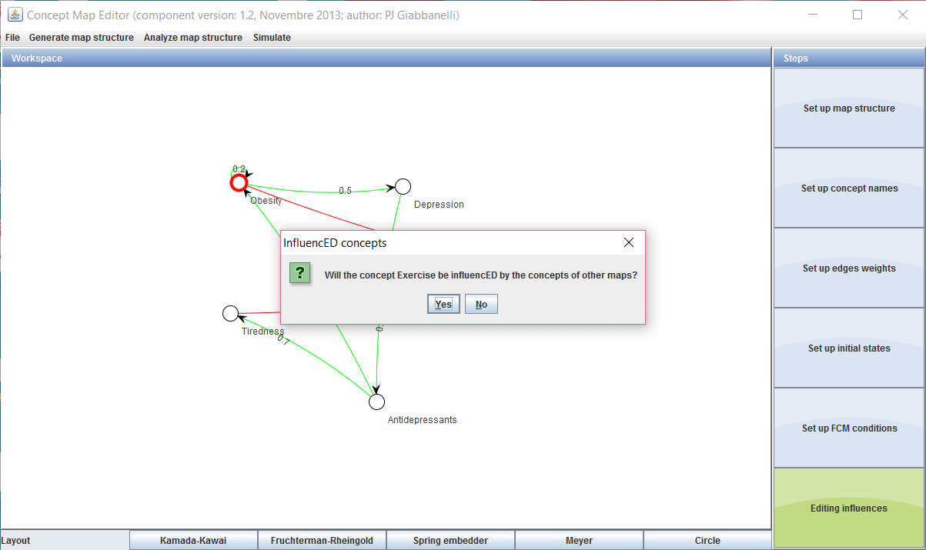
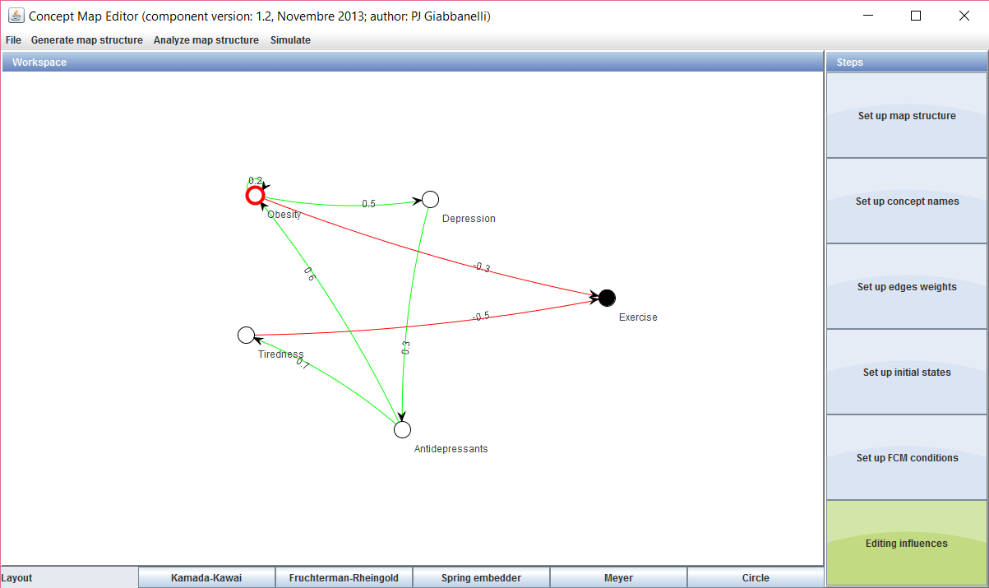
Doing it in practice
Giabbanelli et al.
Hybrid quantitative modeling
32

Slide 33
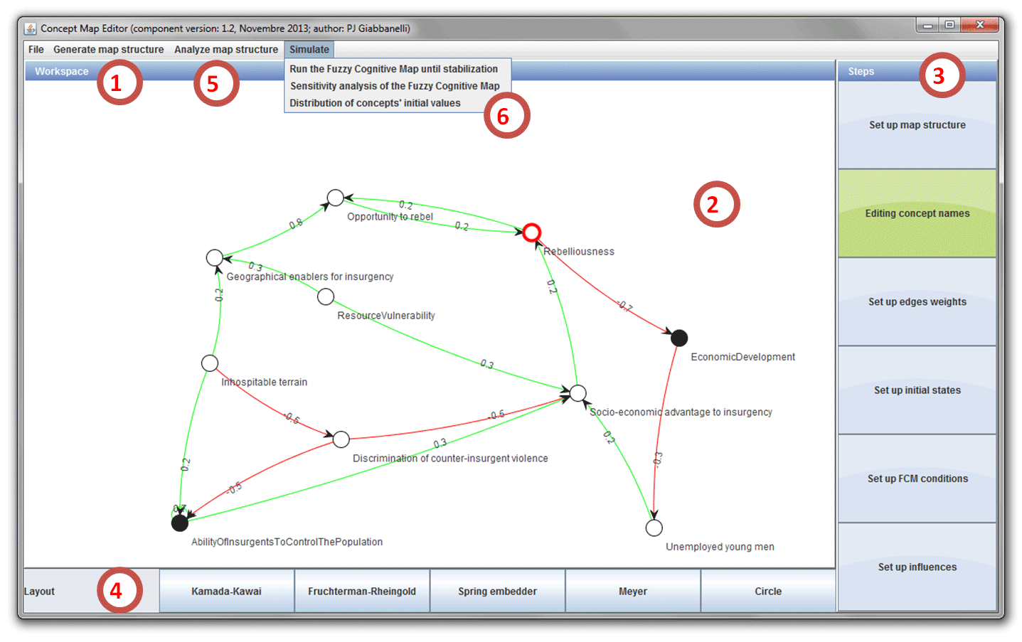
Doing it in practice
Giabbanelli et al.
Hybrid quantitative modeling
33

Slide 34
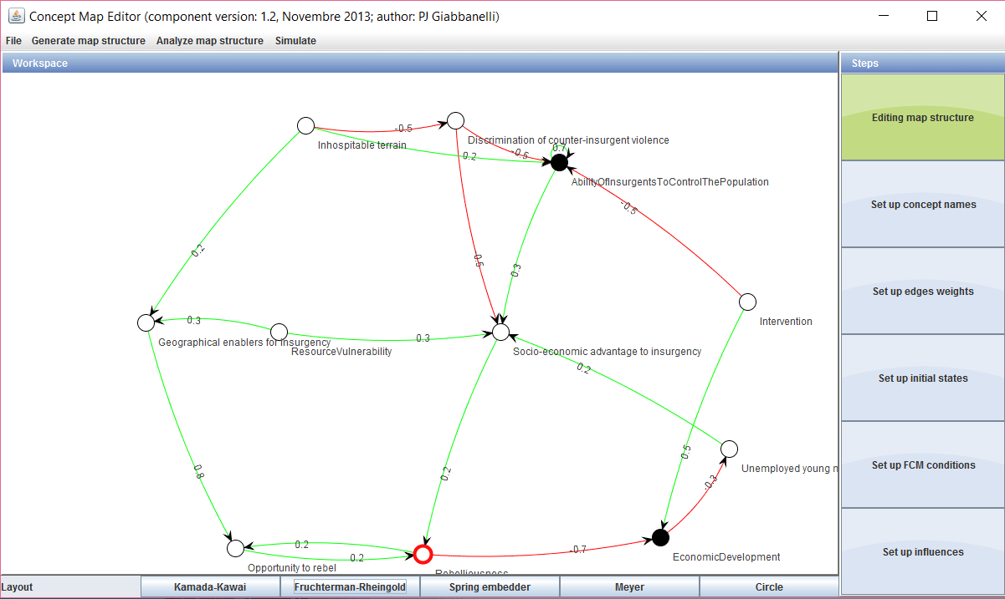
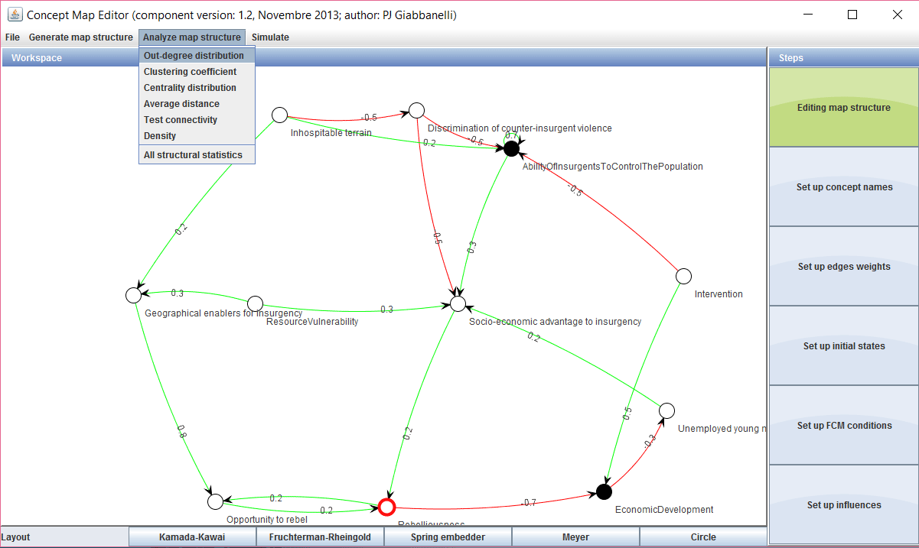
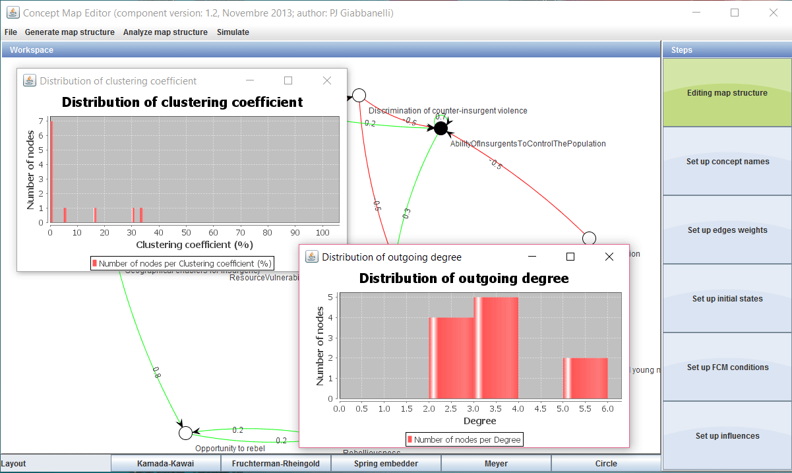
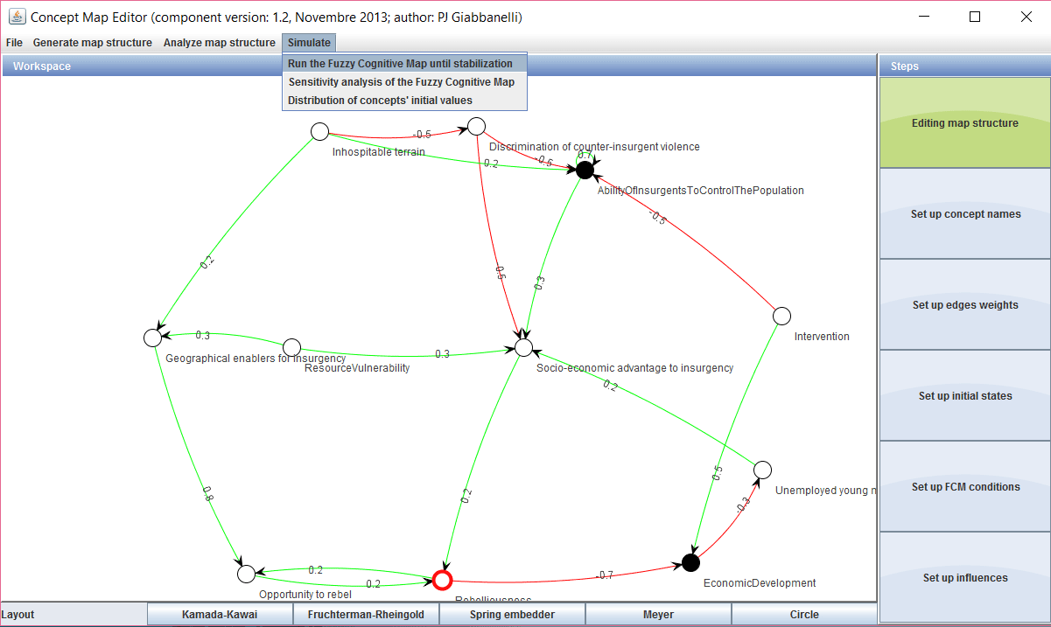
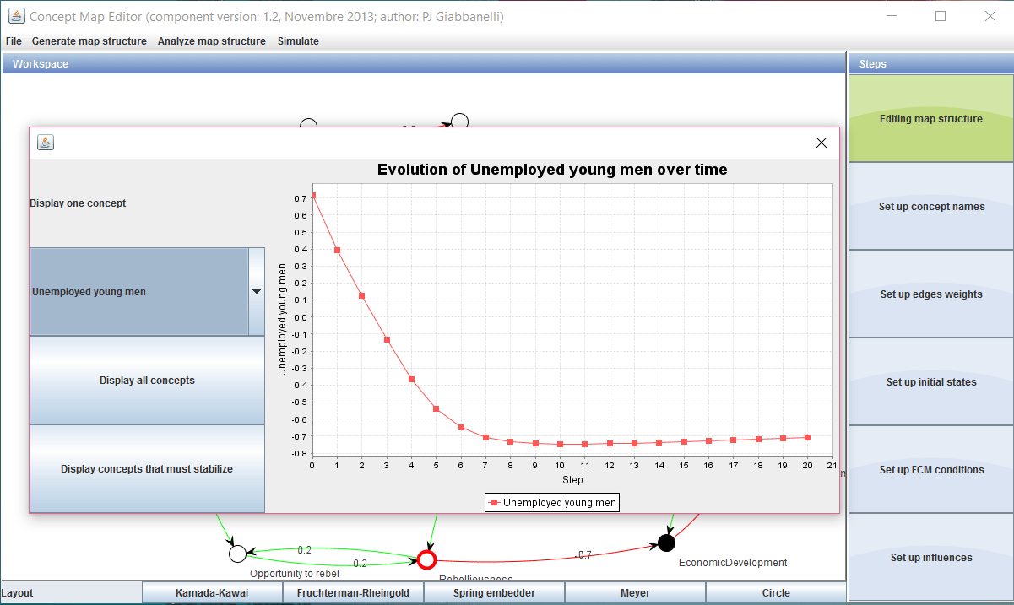
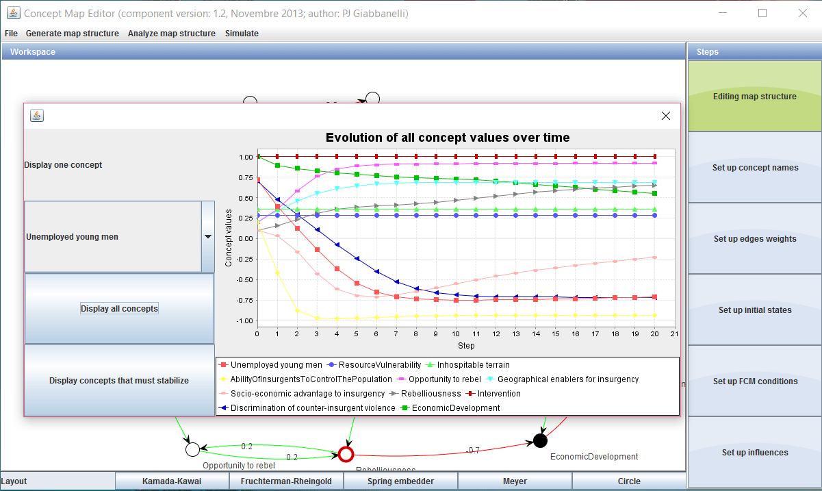
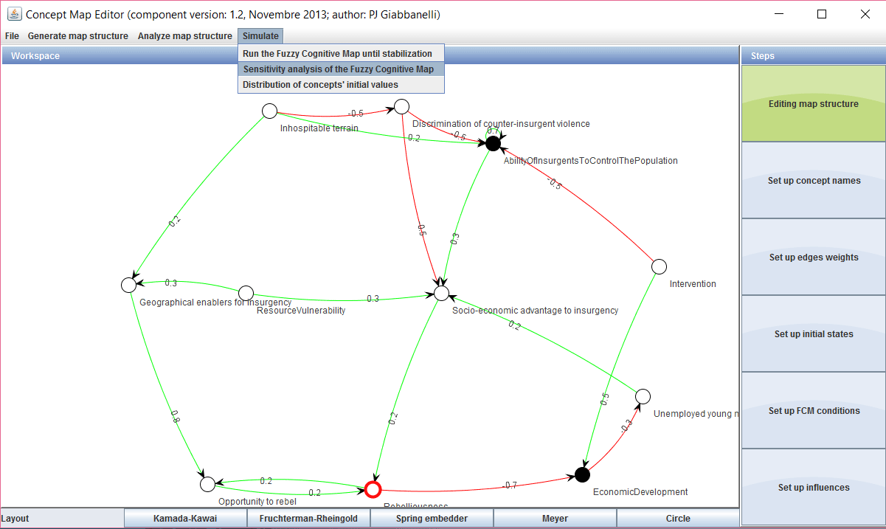
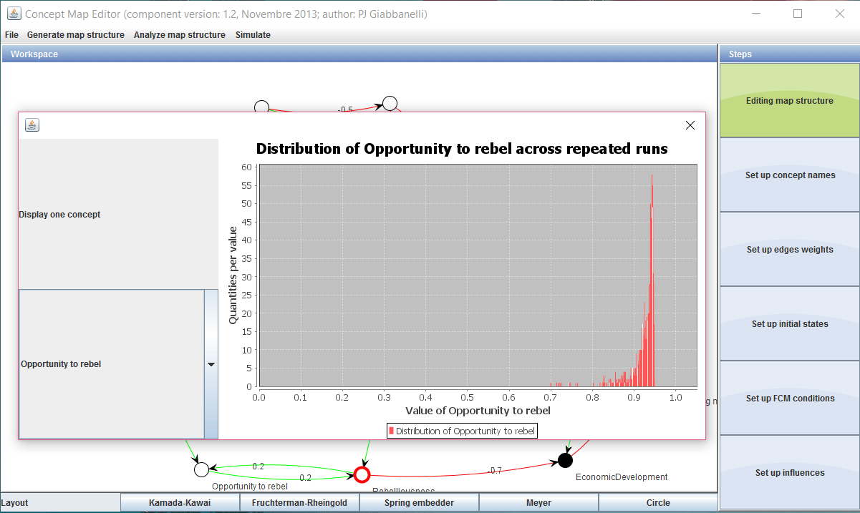
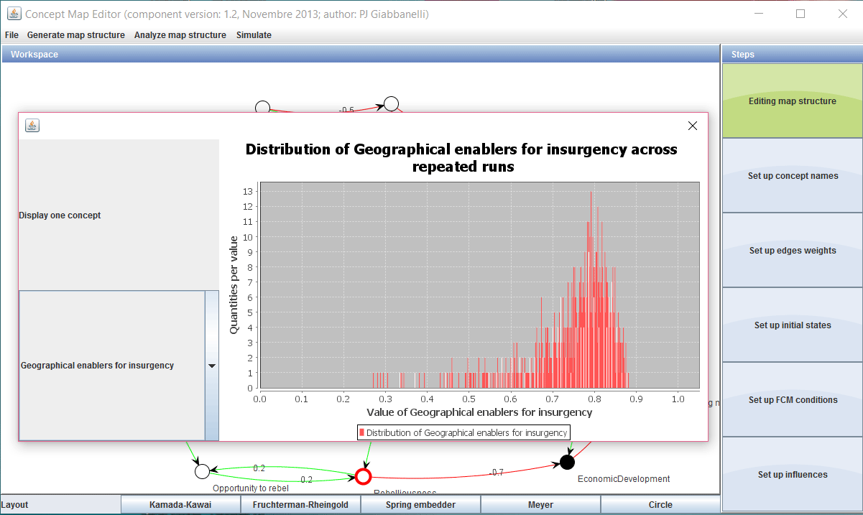
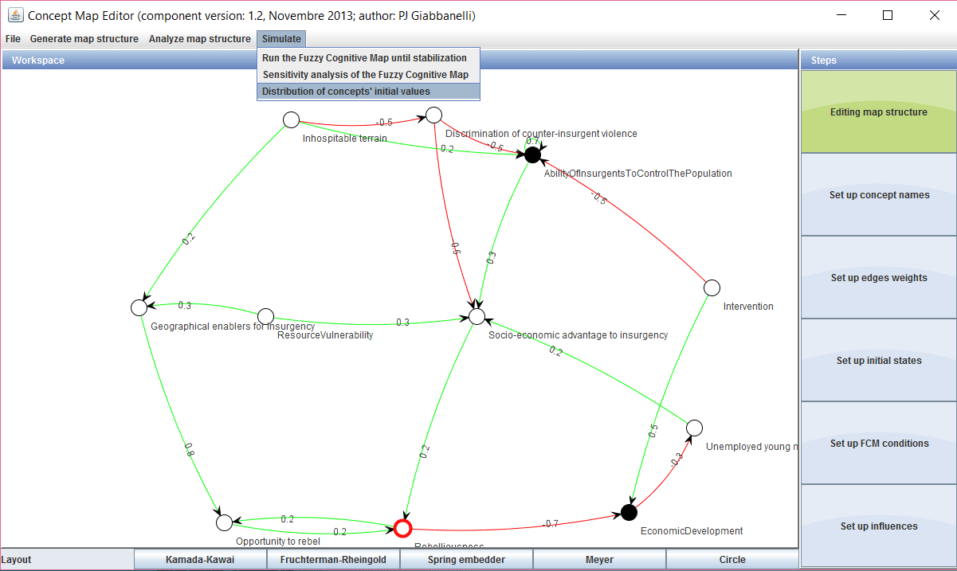
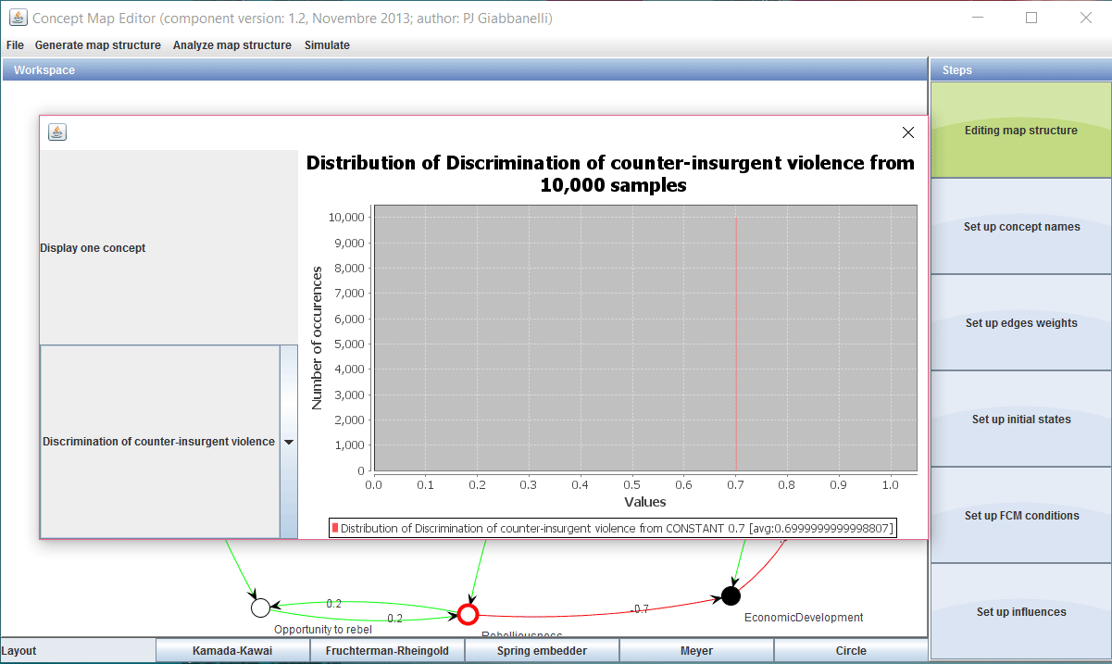
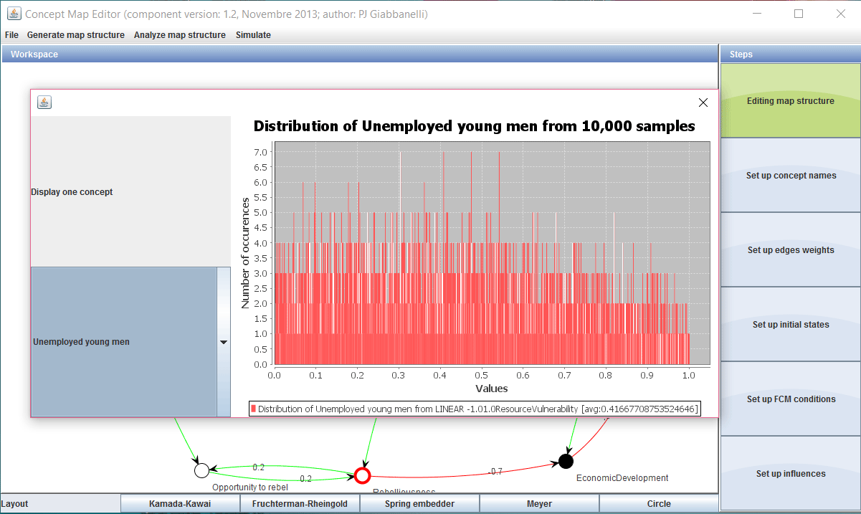
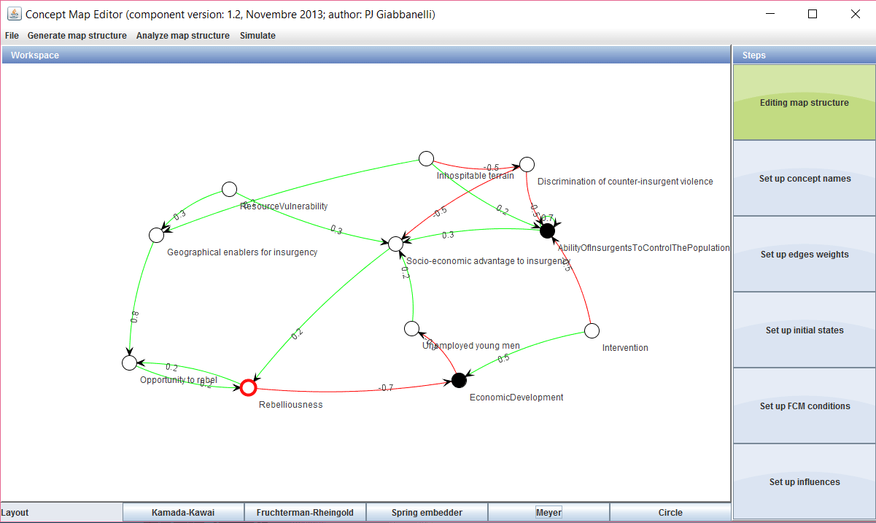
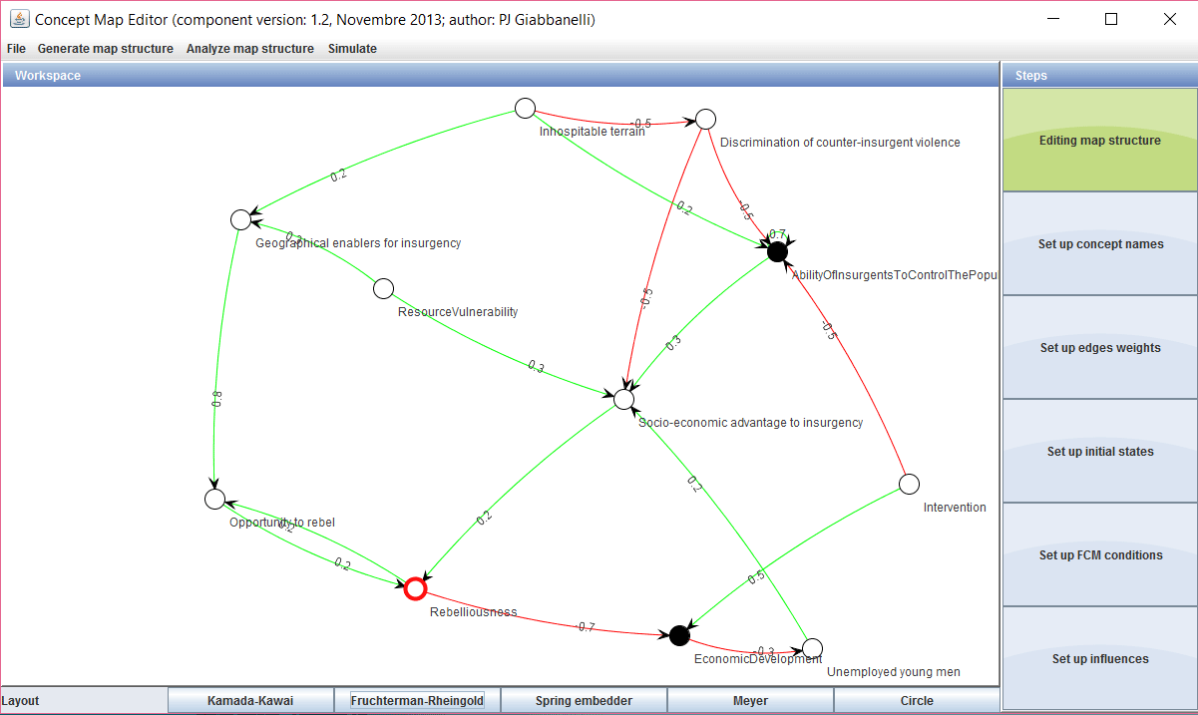
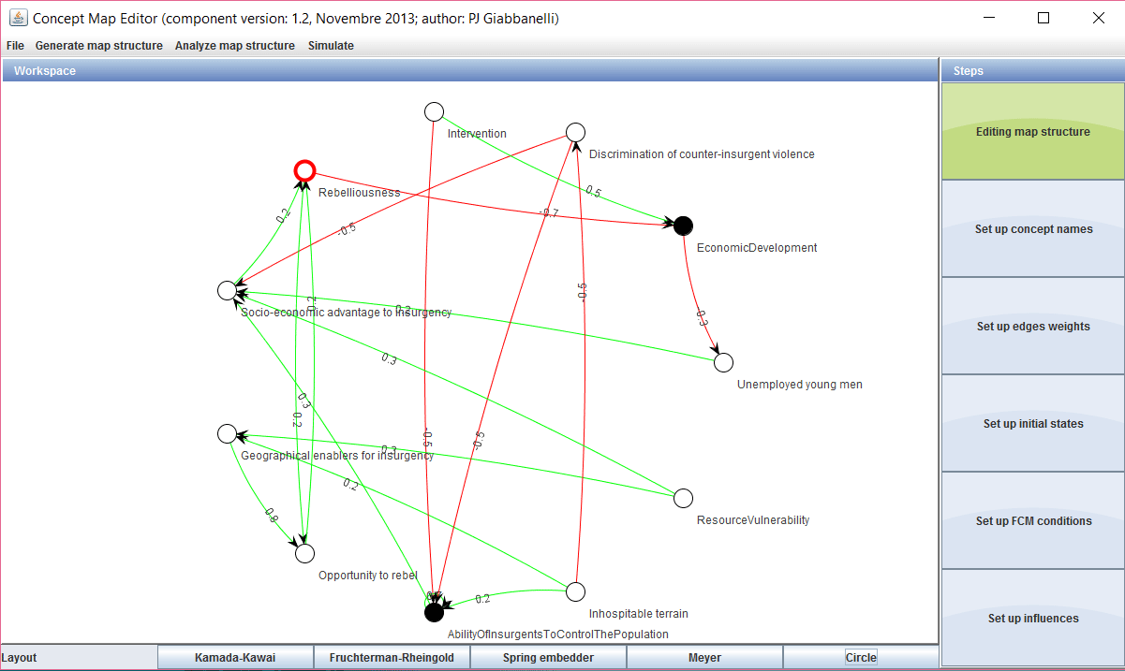
Doing it in practice
Giabbanelli et al.
Hybrid quantitative modeling
34

Slide 35
Doing it in practice
Giabbanelli et al.
Hybrid quantitative modeling
35

Slide 36
Doing it in practice
Giabbanelli et al.
Hybrid quantitative modeling
36

Slide 37
Doing it in practice
Giabbanelli et al.
Hybrid quantitative modeling
37

Slide 38
Doing it in practice
Giabbanelli et al.
Hybrid quantitative modeling
38

Slide 39
Doing it in practice
Giabbanelli et al.
Hybrid quantitative modeling
39

Slide 40
What’s next?
Giabbanelli et al.
Hybrid quantitative modeling
40

Slide 41
What’s next? Learning more
Giabbanelli et al.
Hybrid quantitative modeling
41

Slide 42
What’s next? Learning more
Giabbanelli et al.
Hybrid quantitative modeling
42

Slide 43
What’s next? Putting it to practice
Use AnyLogic to combine agent-based models and system dynamics. It’s based in Java and, while it features a drag-and-drop for model elements, you’ll have to code.
or
if you want to combine networks/agent-based with fuzzy cognitive maps (like we presented), talk to us. We can help you with model design and implementation.
or
Design models using a single paradigm (e.g. ABM) because you don’t have the time or data, but be aware of the big simplifications you may be making.
Giabbanelli et al.
Hybrid quantitative modeling
43

Slide 44
Questions?
giabba@cs.niu.edu
www.dachb.com
Thanks to the students
Giabbanelli et al.
Hybrid quantitative modeling
44

